Slide 1

PROJECT SUBMISSION — GROUP PRESENTATION
UNIVERSITY
WEB PAGE
PRESENTED BY
Okith SC/2024/14241
Mirun SC/2024/14295
Oshini SC/2024/14260
Hansana SC/2024/14246
Design and development of a comprehensive academic platform for students and faculty.
Yehani SC/2024/14249
FRAMEWORKS
HTML • CSS • JS • NODEJS • MYSQL

Slide 2






















Introduction to the Project
The university website serves as a central platform for students, staff, and visitors, acting as the primary digital gateway to academic life.
Home Page
Departments
Courses
News
Contact
The central hub and starting point for all users.
Specific information regarding academic units.
Comprehensive list of academic offerings.
Latest updates, announcements, and articles.
Direct communication channels for inquiries.
Primary Project Goal
FOCUS AREAS
To create a simple, clean, and user-friendly experience that prioritizes accessibility and accurate information delivery.
Responsive Design
Intuitive Navigation

Slide 3












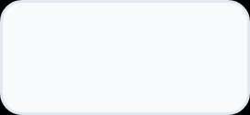

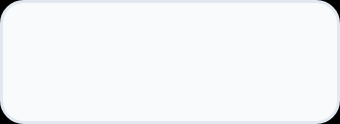
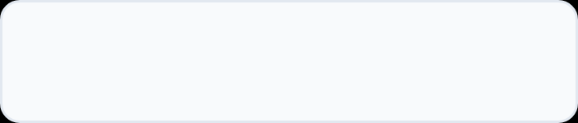





Project Methodology
A collaborative approach to full-stack web development.
Collaboration & Version Control
Code Editor
Centralized repository management via GitHub
Coding and programming via VS Code
Task division among group members
Task management within the team.
Efficient component integration
Powerful extensions for efficient code handling.
Frontend
Backend & Database
HTML5
CSS
JavaScript
NodeJS
XAMPP
Focused on creating a clean, responsive interface that ensures easy navigation for students and staff.
Apache
MySQL
DEVELOPMENT ENVIRONMENT
INTEGRATED WEB ARCHITECTURE

Slide 4













PROJECT SHOWCASE
WEBSITE FEATURES
Home Page
Department Pages
Central hub providing overview and quick access to sections.
Dedicated spaces for various academic departments.
DEMONSTRATION FOCUS
01
Clean & Modern UI
Minimalist design with content focus.
02
Responsive Navigation
Programs Page
Optimized for all devices.
Catalog of available programs and modules.
03
Information Hierarchy
Structured data for easy discovery.
LIVE DEMO PREPARED
News Page
Contacts Pages
Faculty news and upcoming important dates.
Faculty directory with contact info and expertise.
.

Slide 5



NAVIGATING OBSTACLES
CHALLENGES FACED
VERSION CONTROL & GITHUB
ACADEMIC TIME MANAGEMENT
FULL-STACK INTEGRATION
Setting up the repository and resolving complex merge conflicts during team collaboration required significant coordination and learning.
Balancing intensive development tasks with regular lectures and ongoing studies was a major logistical hurdle for the team.
Seamlessly connecting the frontend interface with the NodeJS backend and MySQL database required careful architecture and debugging.

Slide 6













FUTURE ENHANCEMENTS
UI/UX & Responsiveness
User Access Systems
Refining the interface for seamless experience across devices.
Secure login portals for students and staff dashboards.
Database Expansion
AI Chatbots
Expanding architecture to support larger datasets.
Implementing AI chatbots for instant and personalized support
PHASE 2.0
NEXT STEPS

Slide 7








Conclusion
Web Development
Teamwork
Version Control
Integrated frontend (HTML/CSS/JS) with backend (NodeJS/MySQL) architectures.
Developed collaboration skills through task division and synchronized development.
Mastered GitHub workflows and conflict resolution for project integrity.
THANK YOU
We are now open Q & A
University Web Page Project

